Slide 1
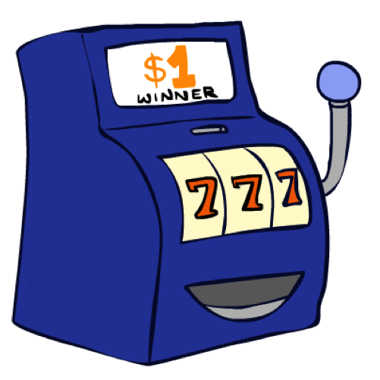
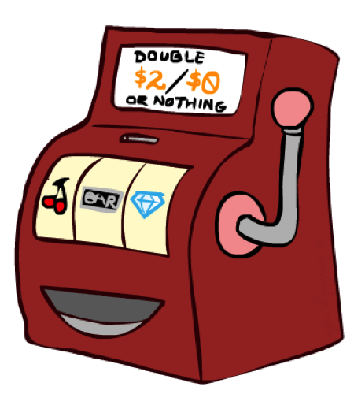

Double Bandits
Notes:
one-armed bandit A slot machine, as in It's amazing how many people think they can make money playing a one-armed bandit. This term refers to both appearance and function: the operating lever looks like an arm, and the machine in effect robs players, since it “wins” and keeps the player's money in an overwhelming majority of instances

Slide 2
Double-Bandit MDP
Actions: Blue, Red
States: Win, Lose
No discount
100 time steps
Both states have the same value
0.25 $0
0.75
$2
W
L
0.25
$0
$1
1.0
$1
1.0
0.75 $2

Slide 3
Offline Planning
Solving MDPs is offline planning
You determine all quantities through computation
You need to know the details of the MDP
You do not actually play the game!
No discount
100 time steps
Both states have the same value
0.25 $0
Value
0.75
$2
W
0.25
$0
Play Red
150
L
$1
1.0
$1
1.0
0.75 $2
Play Blue
100

Slide 4
Let’s Play!
$2
$2
$0
$2
$2
$2
$2
$0
$0
$0
Notes:
What actually happens? We actually won real fake money, instead of just thinking about it. We won $12 for 10 plays. Instead of our estimate of $15.

Slide 5
Online Planning
Rules changed! Red’s win chance is different.
?? $0
??
$2
W
L
??
$0
$1
1.0
$1
1.0
?? $2
Notes:
Now we aren’t given the probabilities. Red has a payoff but you don’t know what it is.
We don’t know the MDP! We can’t calculate its values. So what should we do? Give up and go home? No, let’s try it out by playing.

Slide 6
Let’s Play!
$0
$0
$0
$2
$0
$2
$0
$0
$0
$0
Notes:
Who wants to play red? Do we know that’s the optimal policy? What should we play? Red! Red! Red! When should we stop?
This is a different setting. Red is an MDP. It has a payoff. You don’t know what it is.
What you have to do is an optimal amount of discovery mixed in with not losing your money.

Slide 7
What Just Happened?
That wasn’t planning, it was learning!
Specifically, reinforcement learning
There was an MDP, but you couldn’t solve it with just computation
You needed to actually act to figure it out
Important ideas in reinforcement learning that came up
Exploration: you have to try unknown actions to get information
Exploitation: eventually, you have to use what you know
Regret: even if you learn intelligently, you make mistakes
Sampling: because of chance, you have to try things repeatedly
Difficulty: learning can be much harder than solving a known MDP
Notes:
Difficulty: In the original case, it was instantly obvious that you should always play red. Here your lack of knowledge makes it much more difficult to figure out the optimal policy.

Slide 8
Reinforcement Learning
Agent
State: s
Reward: r
Actions: a
Environment
Basic idea:
Receive feedback in the form of rewards
Agent’s utility is defined by the reward function
Must (learn to) act so as to maximize expected rewards
All learning is based on observed samples of outcomes!
Notes:
Basic idea: you have an agent who is acting as always. The agent has actions available to it, and chooses and action.
The environment then does what it always does. It resolves the action. It does this with some non-determinism like before. What the agent gets back from the environment is two things. One is the instantaneous reward. The reward can be a bonus or penalty. This is the thing that we want to learn to maximize. The other thing it gets back is a percept. In the simplest formulation this will be the state that it ends up in, later on we’ll see how to relax this.
In this setting, we won’t know what actions will produce what rewards before we try them. Therefore, we have to learn based on experience. This can be characterized as learning from samples.

Slide 9
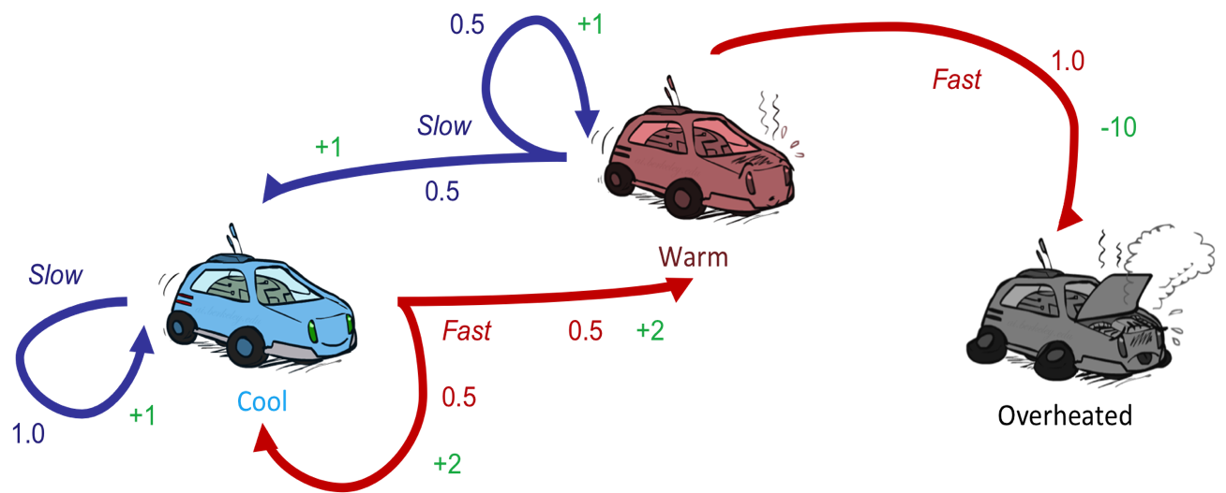
Reinforcement Learning
Still assume a Markov decision process (MDP):
A set of states s ∈ S
A set of actions (per state) A
A model T(s,a,s’)
A reward function R(s,a,s’)
Still looking for a policy π(s)
New twist: don’t know T or R
I.e. we don’t know which states are good or what the actions do
Must actually try actions and states out to learn
Notes:
How is this done?
In reinforcement learning, we still imagine that there’s a MDP. The goal is still to learn a policy.
The new twist is that we don’t know Tor R.

Slide 10
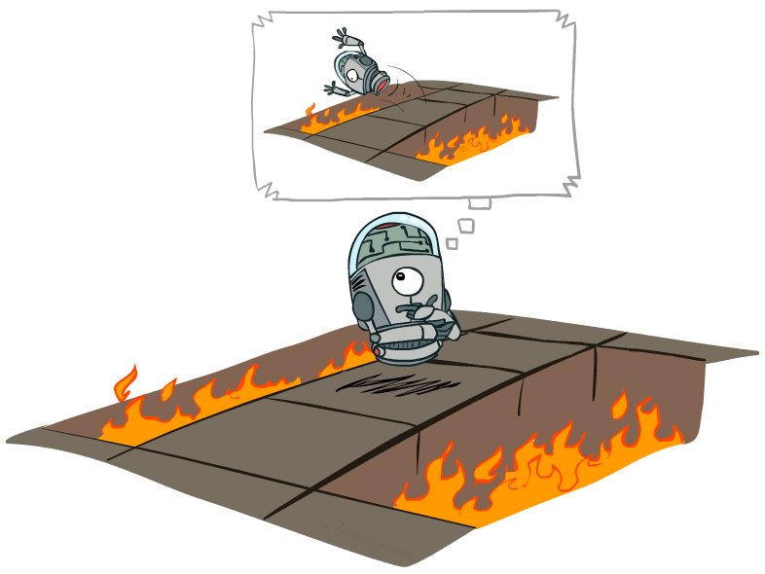
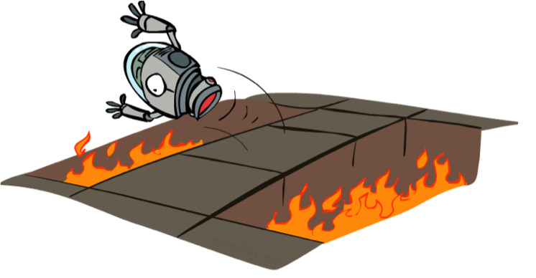
Offline (MDPs) vs. Online (RL)
Offline Solution
Online Learning
Notes:
Offline – in simulation or in your head, you can compute things off and know that it’s bad to jump into the pit.
In online learning, you actually need to take the action.

Slide 11

Model-Based Learning
Notes:
In model based learning, we try to figure out the model by learning the transition functions and the rewards. How does that work?

Slide 12

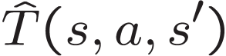

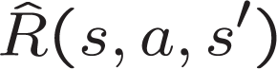
Model-Based Learning
Model-Based Idea:
Learn an approximate model based on experiences
Solve for values as if the learned model were correct
Step 1: Learn empirical MDP model
Count outcomes s’ for each s, a
Normalize to give an estimate of
Discover each when we experience (s, a, s’)
Step 2: Solve the learned MDP
For example, use value iteration, as before
Notes:
We are going to learn an approximate model based on our experiences. Then we’re going to solve for the values as if the learned model were correct.
So how do we do that?
Act for a while. Accumulate counts. Create probabilities. Observe rewards.

Slide 13
Example: Model-Based Learning
Input Policy π
Observed Episodes (Training)
Learned Model
Episode 1
Episode 2
T(s,a,s’).
T(B, east, C) = 1.00
T(C, east, D) = 0.75
T(C, east, A) = 0.25
…
R(s,a,s’).
R(B, east, C) = -1
R(C, east, D) = -1
R(D, exit, x) = +10
…
 | A
B | C | D
 | E
B, east, C, -1
C, east, D, -1
D, exit, x, +10
B, east, C, -1
C, east, D, -1
D, exit, x, +10
Episode 3
Episode 4
E, north, C, -1
C, east, D, -1
D, exit, x, +10
E, north, C, -1
C, east, A, -1
A, exit, x, -10
Assume: γ = 1
Notes:
Someone gives us a policy pi. We say, alright we’re going to do this.
(Here we’re setting the gamma to be one, just to make the example sample).
Ep 1 and 2 are the same.
Ep 3 and 4 are different.
We can then used these observations to compute a model.
The transition from B having selected East results in C 100% of the time.
The transiition from C having picked the action East results in D 75% of the time and A 25% of the time.
Now we have a transition function (probabilities) and the reward function. We now have an MDP. It’s the wrong MDP, but we can solve it.

Slide 14
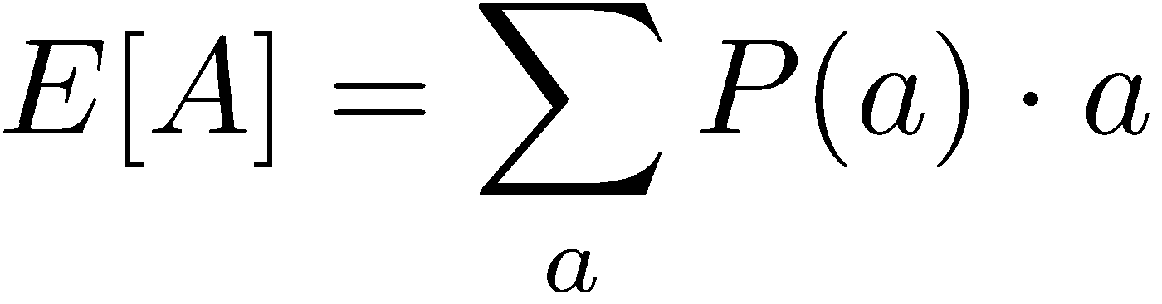
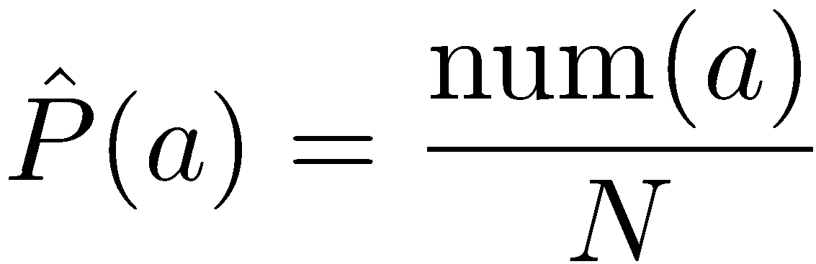
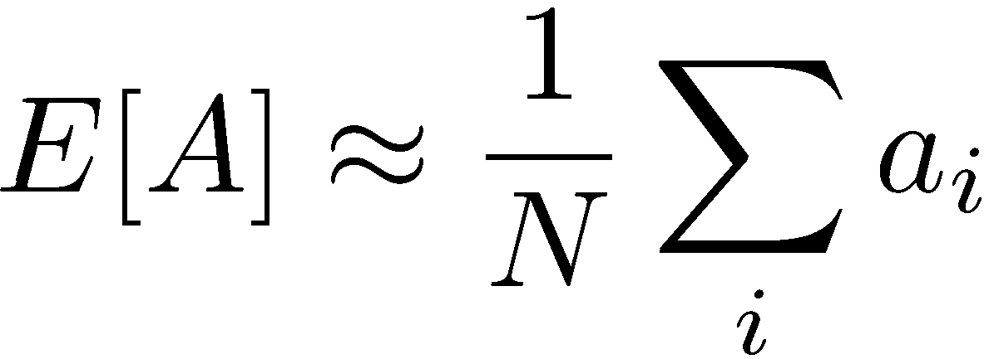
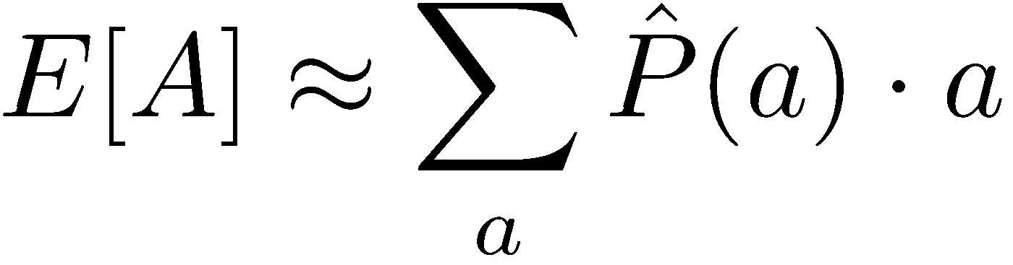
Example: Expected Age
Goal: Compute expected age of CIS 421/521 students
Known P(A)
=0.01 x 42 + …
Without P(A), instead collect samples [a₁, a₂, … a_{N}]
Unknown P(A): “Model Based”
Unknown P(A): “Model Free”
Why does this work? Because eventually you learn the right model.
Why does this work? Because samples appear with the right frequencies.
Notes:
In the model free version we don’t weight by the probability.
But in this case they’re equivalent, since they will appear with the right frequency.
It’s really just a matter of how and when you group things.
In the reinforcement learning there is going ot be a difference because we will take the structure into account. Things are going to depend on the other states around them.
But this gives a good high-level overview of what we mean by model-based v. model free.

Slide 15
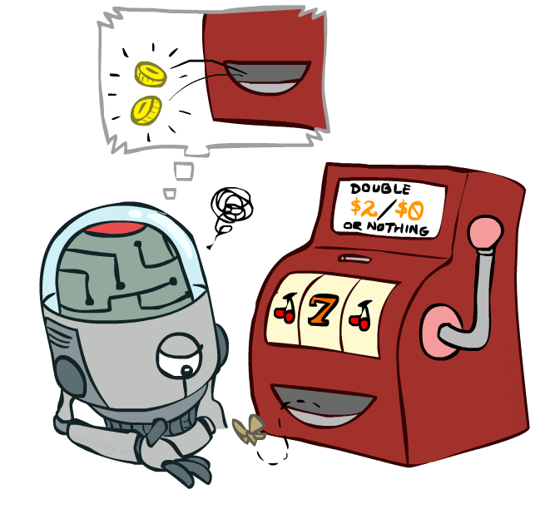
Model-Free Learning
Notes:
now we're going to talk about model free
learning and model free learning we
don't construct a model of the transition function
Instead, we take actions and every time we take an action we compare what we thought was going to happen to what actually did happen.
Whenever something is better or worse than what we expected we adjust our values up and down.
So what we track in a model free approach is the values of interest themselves not the transition functions or the rewards.

Slide 16
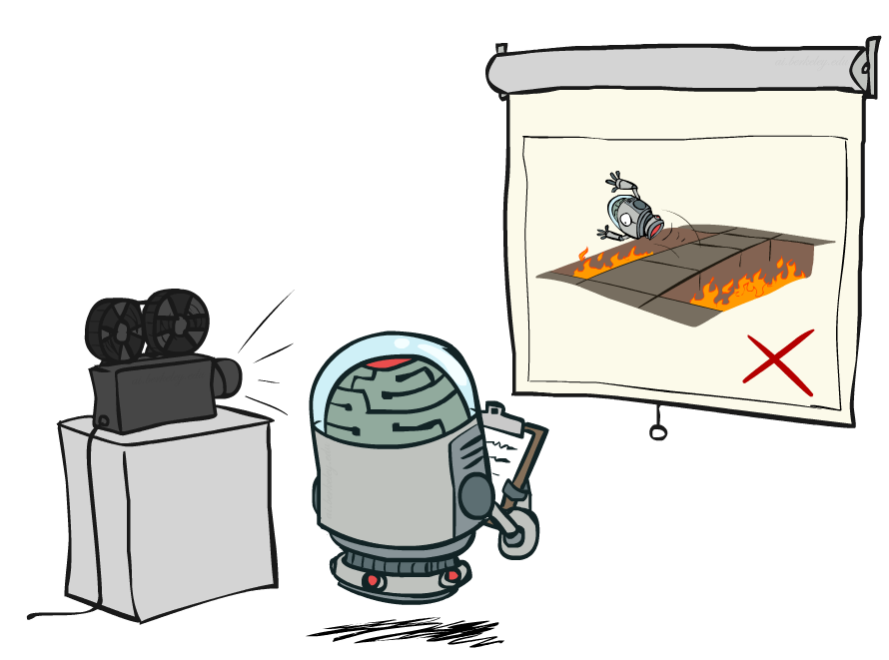
Passive Reinforcement Learning
Notes:
In passive reinfocement learning, someone else chooses the policy. And we observe what happens.
The passive case is this simplified task. We're not going to try to figure out how to act optimally.
We're going try to figure out essentially what policy evaluation did.
The input is a fixed policy. We want to evaluate it.

Slide 17

Passive Reinforcement Learning
Simplified task: policy evaluation
Input: a fixed policy π(s)
You don’t know the transitions T(s,a,s’)
You don’t know the rewards R(s,a,s’)
Goal: learn the state values
In this case:
Learner is “along for the ride”
No choice about what actions to take
Just execute the policy and learn from experience
This is NOT offline planning! You actually take actions in the world.

Slide 18
Direct Evaluation
Goal: Compute values for each state under π
Idea: Average together observed sample values
Act according to π
Every time you visit a state, write down what the sum of discounted rewards turned out to be
Average those samples
This is called direct evaluation

Slide 19
Example: Direct Evaluation
Input Policy π
Observed Episodes (Training)
Output Values
Episode 1
Episode 2
 | A
B | C | D
 | E
 | A
B | C | D
 | E
B, east, C, -1
C, east, D, -1
D, exit, x, +10
B, east, C, -1
C, east, D, -1
D, exit, x, +10
-10
+8
+4
+10
Episode 3
Episode 4
-2
E, north, C, -1
C, east, D, -1
D, exit, x, +10
E, north, C, -1
C, east, A, -1
A, exit, x, -10
Assume: γ = 1
Notes:
We’re given an input policy
We just want to evaluate it.
What utility did I receive from B? Not -1. That was the intentions reward. I want to compute the utility, which is from B until the end. So +8.
Write down what happened.
Why 4 for C? 9 + 9 + 9 - 11 = 16/4 = 4

Slide 20
Problems with Direct Evaluation
What’s good about direct evaluation?
It’s easy to understand
It doesn’t require any knowledge of T, R
It eventually computes the correct average values, using just sample transitions
What bad about it?
It wastes information about state connections
Each state must be learned separately
So, it takes a long time to learn
Output Values
 | A
B | C | D
 | E
-10
+8
+4
+10
-2
If B and E both go to C under this policy, how can their values be different?

Slide 21

Why Not Use Policy Evaluation?
s
Simplified Bellman updates calculate V for a fixed policy:
Each round, replace V with a one-step-look-ahead layer over V
This approach fully exploited the connections between the states
Unfortunately, we need T and R to do it!
Key question: how can we do this update to V without knowing T and R?
In other words, how to we take a weighted average without knowing the weights?
π(s)
s, π(s)
s, π(s),s’
s’

Slide 22
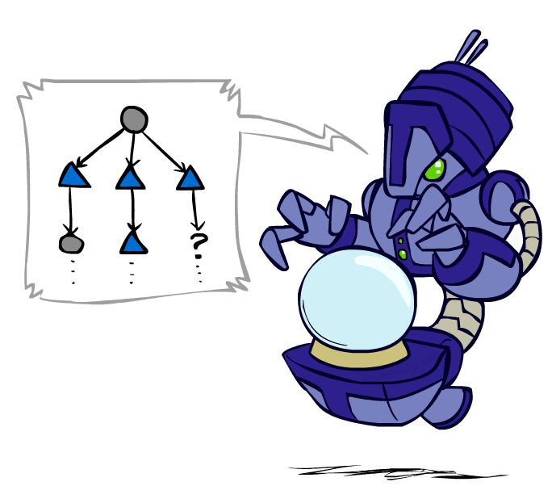
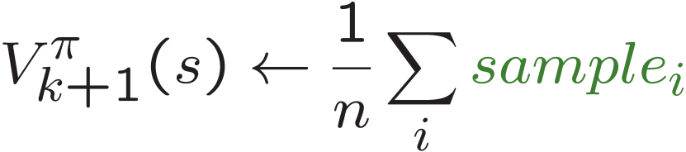
Sample-Based Policy Evaluation?
We want to improve our estimate of V by computing these averages:
Idea: Take samples of outcomes s’ (by doing the action!) and average
s
π(s)
s, π(s)
s, π(s),s’
s₁'
s₂'
s'
s₃'
Almost! But we can’t rewind time to get sample after sample from state s.
Notes:
Can we do sample based policy evaluation?
What’s wrong with this? We don’t get to do lots of actions from state s. We don’t get to rewind and re-do it to get multiple observations.

Slide 23
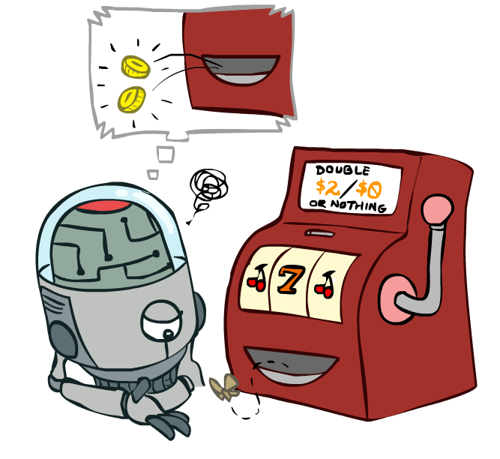
Temporal Difference Learning

Slide 24
Temporal Difference Learning
Big idea: learn from every experience!
Update V(s) each time we experience a transition (s, a, s’, r)
Likely outcomes s’ will contribute updates more often
Temporal difference learning of values
Policy still fixed, still doing evaluation!
Move values toward value of whatever successor occurs: running average
s
π(s)
s, π(s)
s’
Sample of V(s):
Update to V(s):
Same update:
Notes:
The reason this is called temporal difference learning is because we compare our current estimate of a value with what we actually see
Interprolation

Slide 25
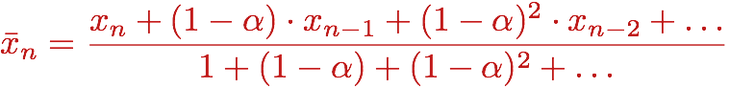
Exponential Moving Average
Exponential moving average
The running interpolation update:
Makes recent samples more important:
Forgets about the past (distant past values were wrong anyway)
Decreasing learning rate (alpha) can give converging averages

Slide 26
Example: Temporal Difference Learning
States
Observed Transitions
B, east, C, -2
C, east, D, -2
 | A
B | C | D
 | E
 | 0
0 | 0 | 8
 | 0
 | 0
-1 | 0 | 8
 | 0
 | 0
-1 | 3 | 8
 | 0
Assume: γ = 1, α = 1/2

Slide 27
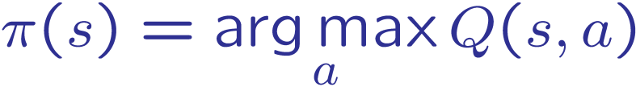
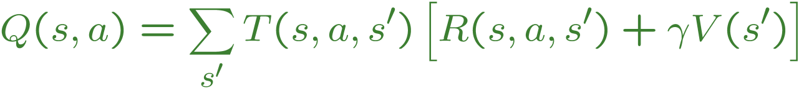
Problems with TD Value Learning
TD value leaning is a model-free way to do policy evaluation, mimicking Bellman updates with running sample averages
However, if we want to turn values into a (new) policy, we’re sunk:
Idea: learn Q-values, not values
Makes action selection model-free too!
s
a
s, a
s,a,s’
s’

Slide 28
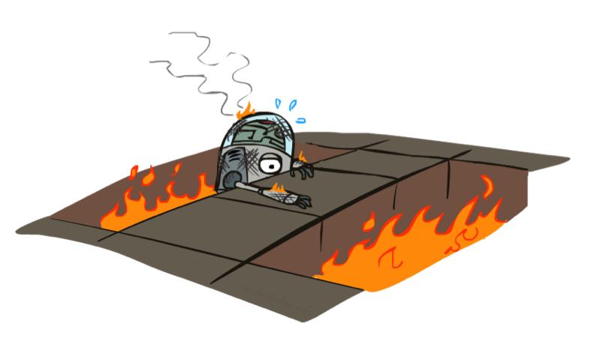
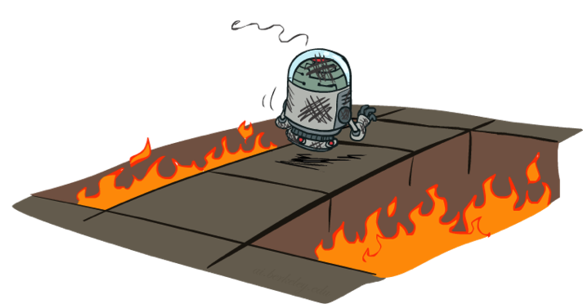
Active Reinforcement Learning

Slide 29
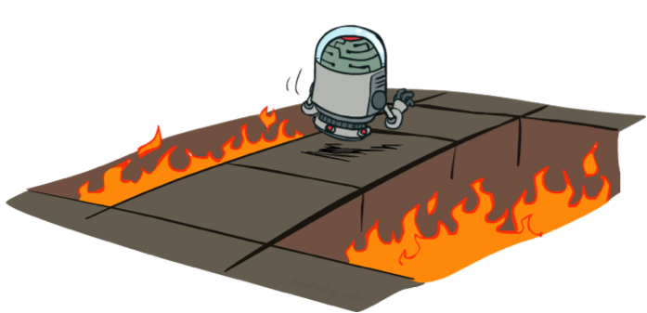
Active Reinforcement Learning
Full reinforcement learning: optimal policies (like value iteration)
You don’t know the transitions T(s,a,s’)
You don’t know the rewards R(s,a,s’)
You choose the actions now
Goal: learn the optimal policy / values
In this case:
Learner makes choices!
Fundamental tradeoff: exploration vs. exploitation
This is NOT offline planning! You actually take actions in the world and find out what happens…

Slide 30
Detour: Q-Value Iteration
Value iteration: find successive (depth-limited) values
Start with V₀(s) = 0, which we know is right
Given V_{k}, calculate the depth k+1 values for all states:
But Q-values are more useful, so compute them instead
Start with Q₀(s,a) = 0, which we know is right
Given Q_{k}, calculate the depth k+1 q-values for all q-states:

Slide 31
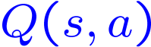
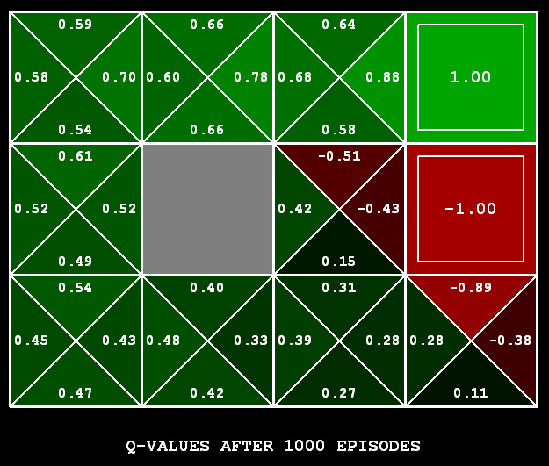
Q-Learning
Q-Learning: sample-based Q-value iteration
Learn Q(s,a) values as you go
Receive a sample (s,a,s’,r)
Consider your old estimate:
Consider your new sample estimate:
Incorporate the new estimate into a running average:

Slide 32
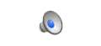
Video of Demo Q-Learning -- Gridworld

Slide 33

Q-Learning Properties
Amazing result: Q-learning converges to optimal policy -- even if you’re acting suboptimally!
This is called off-policy learning
Caveats:
You have to explore enough
You have to eventually make the learning rate
small enough
… but not decrease it too quickly
Basically, in the limit, it doesn’t matter how you select actions (!)

